Slide 1
Digital Sketch Recognition
James Brown, Eric Doi,
Emily Fujimoto, Marty Field
Christine Alvarado

Slide 2
Introduction
Sketching is a natural way to represent many types of data, including circuit diagrams
Computers offer editing and simulation abilities that paper and whiteboards can’t match.

Slide 3
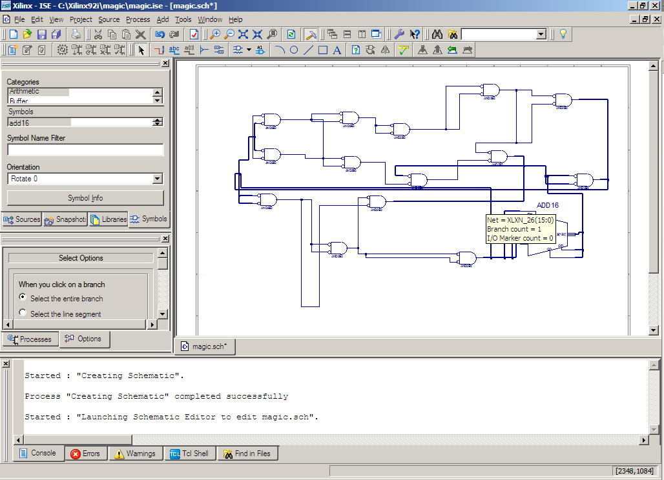
Motivation
“The hardest part of E85 was wrestling with Xilinx” ^{{citation needed}}
Combine the ease-of-use and natural feel of paper with the power of a computer interface.

Slide 4
Process Overview
Input
Labeling
This
Presentation
Grouping
Symbol Recognition
Circuit Recognition
Simulation

Slide 5
Common Features
Pluggable architecture designed to support multiple algorithms with little code
Shared, cached-computation data structures

Slide 6
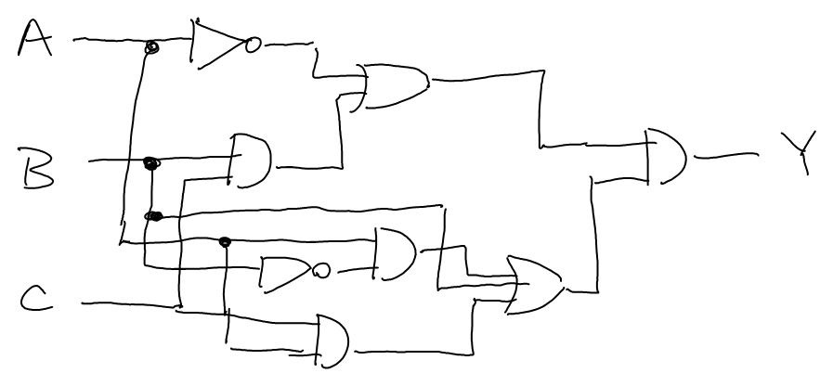
Why Label?
Notes:
Symbol recognizer uses congealing, which is useful because it can take into account the combined visual result of a group of strokes. However, it would take too long to do this for every possible combination of strokes; a basic categorization, such as wires, gates, and labels, makes grouping much simpler.

Slide 7
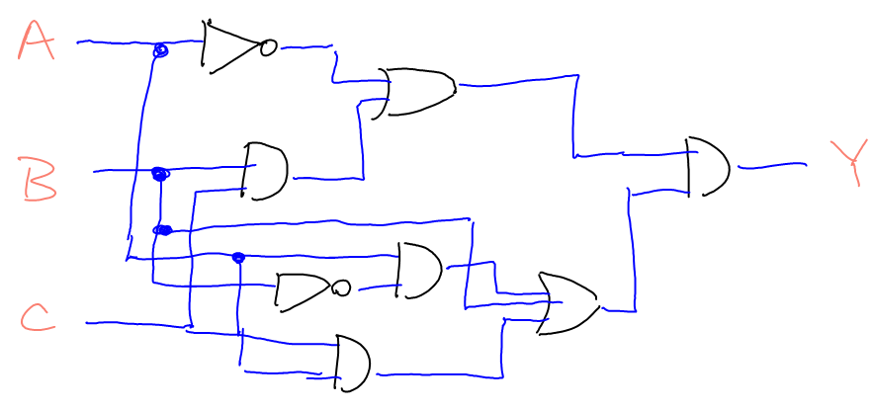
Why Label?
Notes:
Now all we would have to do is consider connected strokes of the same label, and we would have grouped all of our gates, labels, and wires.
How might we do this? We use a probabilistic model called a conditional random field.

Slide 8
Context with a CRF
What is this?
Notes:
A conditional random field provides a good way to account for context.

Slide 9
Context with a CRF
A wire!
What is this?
Notes:
A conditional random field provides a good way to account for context.

Slide 10
Context with a CRF
A wire!
A gate!
What is this?
Notes:
A conditional random field provides a good way to account for context.

Slide 11
Context with a CRF
A wire!
A gate!
What is this?
A label!
Notes:
A conditional random field provides a good way to account for context.

Slide 12
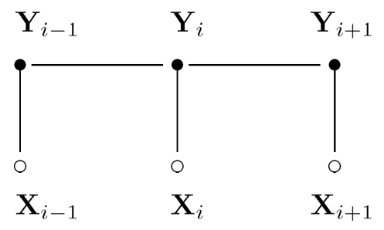
Conditional Random Fields:
A graphical model used to find the conditional probability P(y|x), where x is a set of input data and y is a set of labels. Consists of:
A graph
Two types of “potential” functions
Site
Interaction
P(y|x) can be factored into a weighted product of these potential functions, normalized to a value between 0 and 1.

Slide 13
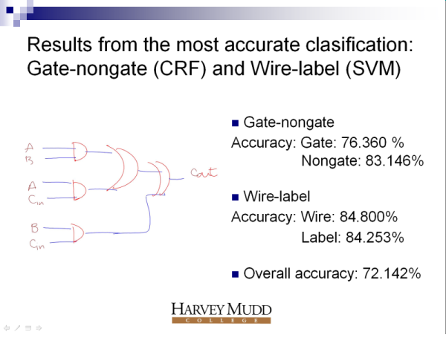
Progress
A slide from last summer’s work
Notes:
Last summer some progress was made by using a combined approach with a CRF and a Support Vector Machine.

Slide 14
Progress
Notes:
Remember this sketch? This is an actual sketch that was processed correctly by just our CRF. We made a good amount of progress this summer with the CRF by changing the inference algorithm we used—last summer, we had been using approximations for speed. However, performing the junction tree algorithm, which calculates the marginal probabilities of the CRF exactly, has improved our three-way classification accuracy to over 90%. We’ve been able to keep the classification at a reasonable speed by making other optimizations and improvements.

Slide 15
Fragmenting
Different domains
Different labeling
Different Training Sets
  High accuracy
  Low time requirement
  Low data requirement
  Trade off

Slide 16
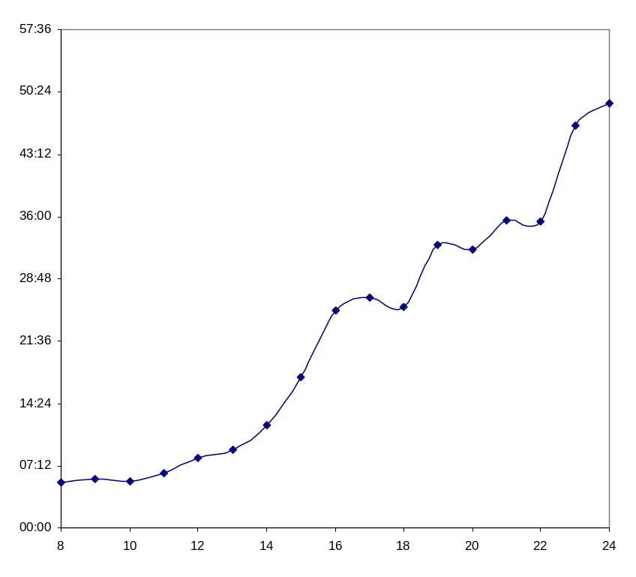
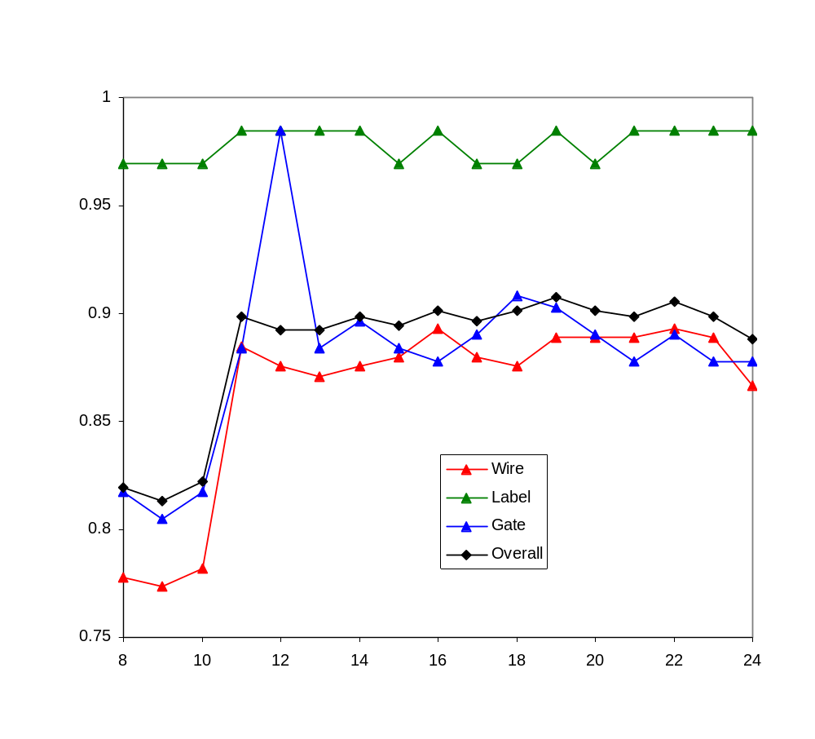
Time
(mm:
ss)
Accuracy
Number of Files Used in Training

Slide 17
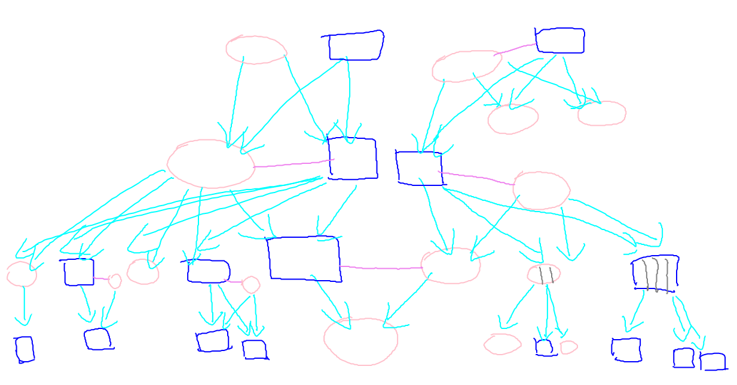
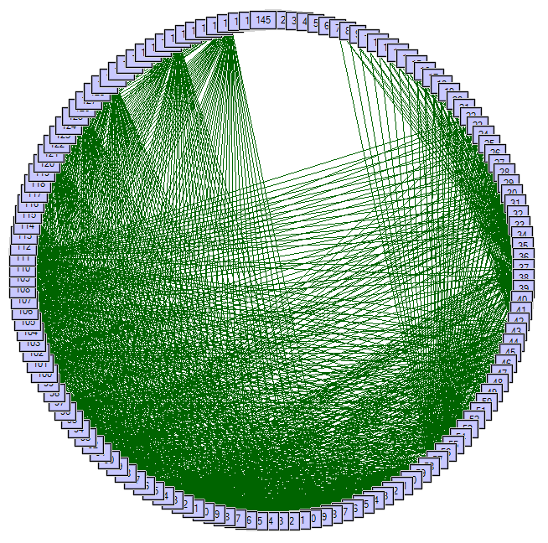
Problems
Notes:
However, the junction tree algorithm does have problems if the graph becomes too complicated.
Family tree has max clique of 30.
Work remains to be done to see if there is a better way to make stroke connections to simplify the graphs while maintaining a reasonable classification accuracy.

Slide 18
Grouping
Use labels from CRF to decide which strokes correspond to which strokes
Combine temporal and spatial data with the CRF’s feature data

Slide 19

Symbol Recognition
Need to turn “gate” into “AND”, “OR”, “NOT”, etc.
Different approaches:
  Feature-based
  Image-based

Slide 20
Symbol Recognition: Congealer
Image-based symbol recognizer
Performs image alignment by a constrained search of affine transforms
Custom distance metric for symbol classification

Slide 21




Symbol Recognition: Congealer
Training
Notes:
Talk about pre-alignment and affine transform search

Slide 22
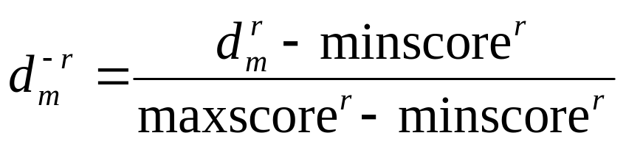
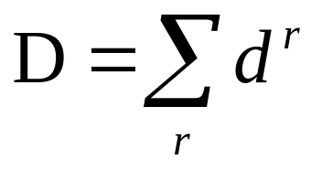
Symbol Recognition: Congealer
Classification
Metrics: Yule, Tanimoto, Hausdorff, Modified Hausdorff
Notes:
Normalize + combine

Slide 23
Symbol Recognition:
Congealer Results
Reliably over 98% recognition on NOT gates, with 53% specificity
About 70% overall

Slide 24

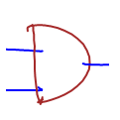

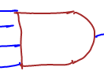
Symbol Recognition:
Congealer Problems
Highly variable sketching styles:
Computationally intensive:
  Over 40 hours to train on a tablet
Notes:
This is a selection of AND gates taken from our data

Slide 25


Symbol Recognition:
As Gestures
Symbol
Gesture
one or many strokes
order and direction
  unimportant to meaning
one stroke only
direction important to meaning
Notes:
Introduction to Symbols vs. Gestures:
Symbol: final shape important
Gesture: act of drawing important

Slide 26
Sketching Style Study
It is easy to collect data by asking users to draw a specific shape.
Is it safe to use this data to train a recognizer?
  What if users draw differently if they have to think about what they’re drawing?
Gestures place emphasis on being drawn the same every time.
Notes:
Motivation for the study

Slide 27
Sketching Style Study
Use gesture recognizers to determine similarity of shapes between drawing tasks.
  Copy task
    Isolated gates
    Entire circuits
  Synthesis task
    Given logical expression, create a circuit
Notes:
Layout of the study:
-train on one activity, test on another
-compare to training and testing on same
-all pairwise combinations

Slide 28
The $1 Gesture Recognizer
0
1
2
3b
3a
Notes:
How do you recognize a gesture?
1991 paper by Dean Rubine: 13 features, complex matrix operations.
2007 paper by Wobbrock, Wilson, and Li presents an extremely effective solution in about 100 lines of code. Outperforms Rubine. Easy to add training examples incrementally.
Step 1: resample
Step 2: rotate, center, scale
Step 3: (for classification) rotation search
Step 3b: (for classification) point-to-point distance

Slide 29
Adding my thoughts to create $1.02
Resample: points per shape
Skip initial rotation
Ignore point order

Slide 30

How do we match the points?
O(N!)
Hausdorff Distance
Greedy
Exact Solution
Notes:
Bad matching algorithms:
Hausdorff distance: match 2 to 1
Greedy: make really poor choices based on order
Optimal: would take forever

Slide 31
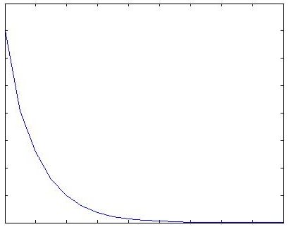
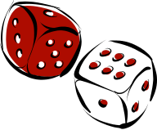
How do we match the points?
Simulated Annealing
current state
random neighbor
dist. = 9
dist. = 10
dist. = 10
dist = 3
decision function
temp
current_dist
neighbor_dist
current_temp
Accept
Reject
time
Notes:
Simulated annealing simulates molecules aligning as a piece of metal cools. When the temperature is high, a wide range of movement is possible.
Parameters:
Initial temperature and cooling function: We used an exponential decay so that it doesn’t have a long time to get off track at the beginning.
Decision function: Takes as parameters the current state distance, the neighbor state’s distance, and the current temp and decides with a random factor if the neighbor state should become the current state.
Initialize current state to the greedy solution.
Generate a neighbor by swapping any pair of points’ matches.
Rinse, repeat.

Slide 32
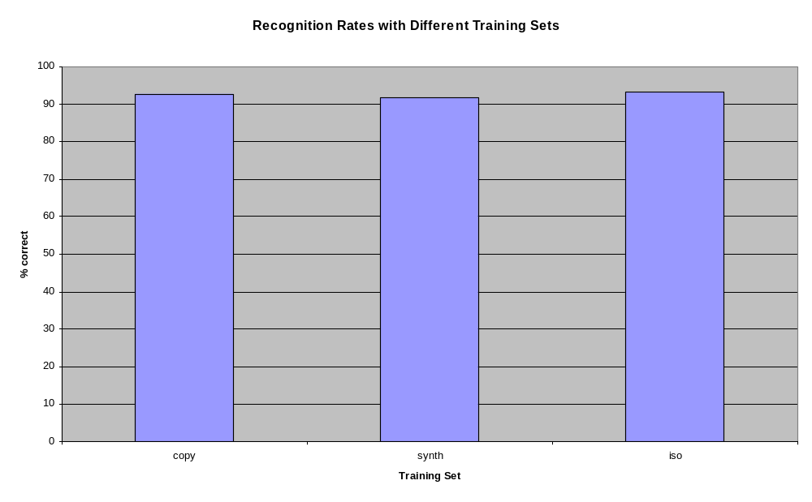
Sketching Style Survey Results
Notes:
The training set used did not have a significant impact on the recognition rates.

Slide 33
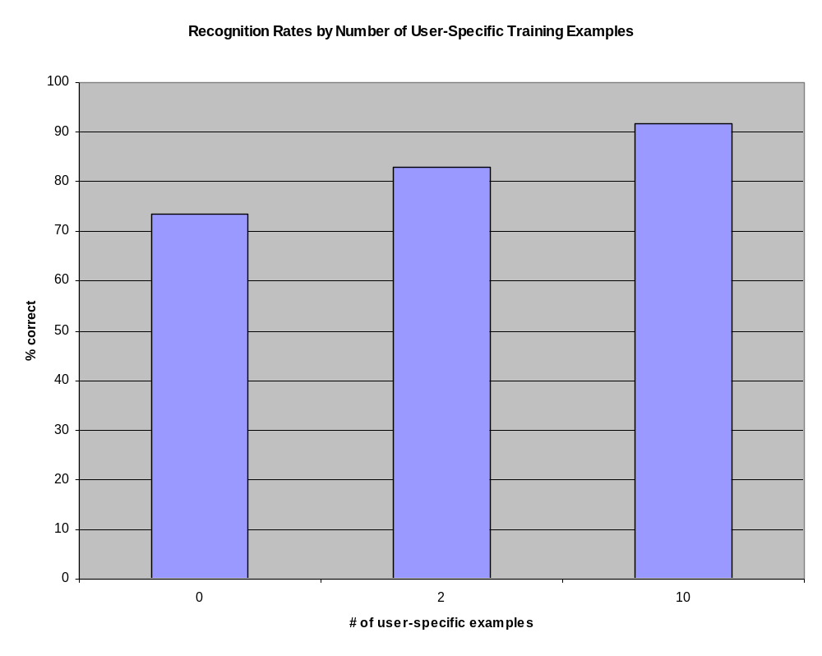
The Effect of User-Specific Training Examples
Notes:
# of user specific training examples did have a significant effect.
Furthermore, evidence indicates that user-specific training examples should replace global training examples as they can be collected.

Slide 34
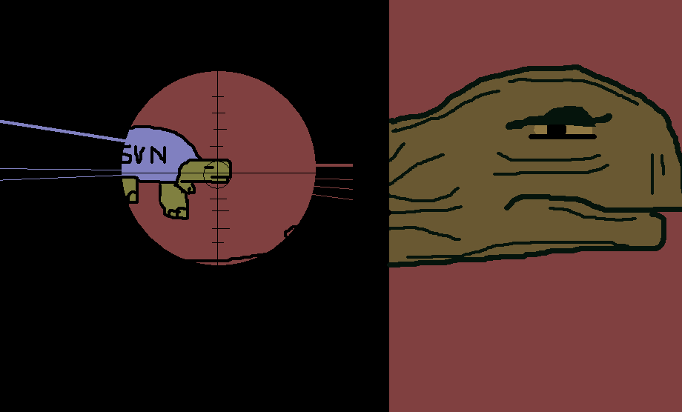
Future Work
Improve symbol recognition algorithms using more recent congealer work
Incorporate feature-based symbol recognition

